Slide 1
Data Structures
Lecture 14
Heaps
Prantik Paul [PNP]
Lecturer
Department of Computer Science and Engineering
BRAC University

Slide 2
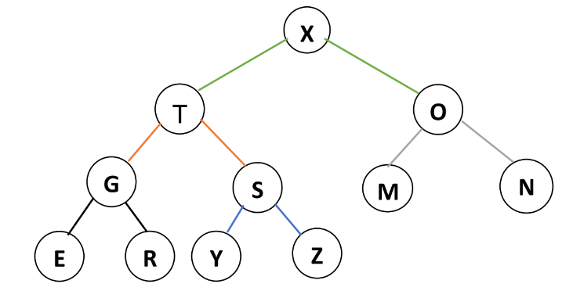



Heap - Special Binary Tree

Slide 3
Heap - Properties
→ Complete
→ Satisfy Heap Property
→ Value of Parent >= Value of Children MaxHeap
→ Value of Parent <= Value of Children MinHeap

Slide 4
Heap - Representation

Slide 5
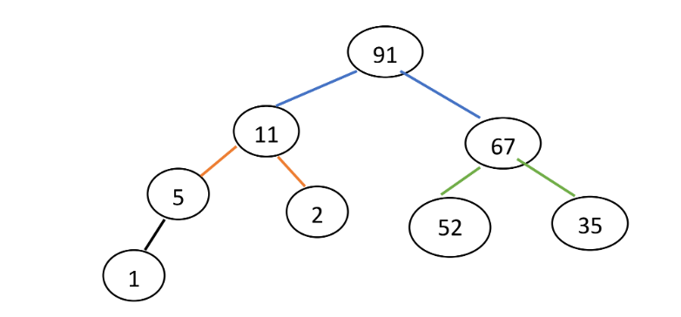
Heap - Insert
Insert 3

Slide 6
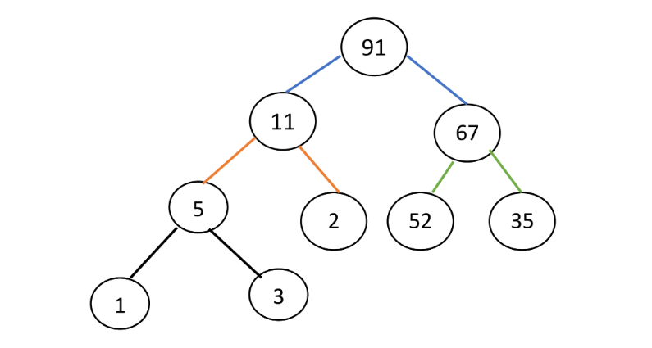
Heap - Insert
Insert 3

Slide 7
Heap - Insert
Insert 102

Slide 8
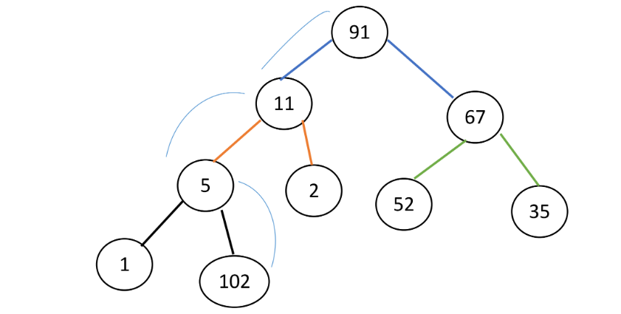
Heap - Insert
Insert 102
Swim()
HeapIncreaseKey()

Slide 9
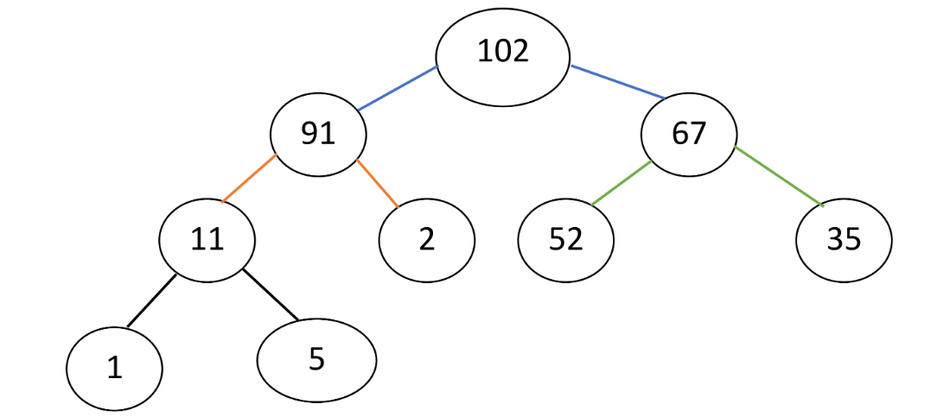
Heap - Insert
Insert 102

Slide 10
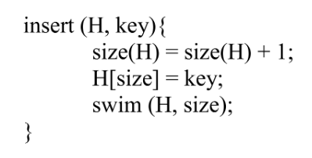
Heap - Insert (Pseudocode)

Slide 11
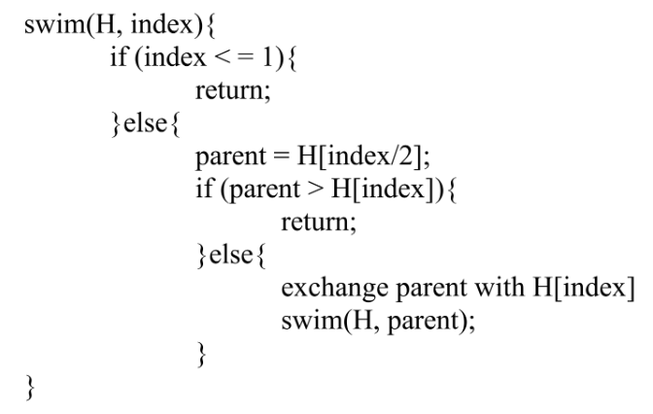
Heap - Swim (Pseudocode)

Slide 12
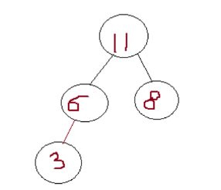
Heap - Delete
Delete Root

Slide 13
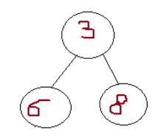
Heap - Delete
Delete Root

Slide 14
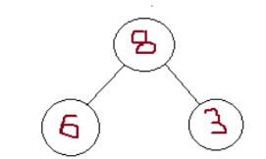
Heap - Delete
Delete Root
Sink()
MaxHeapify()

Slide 15
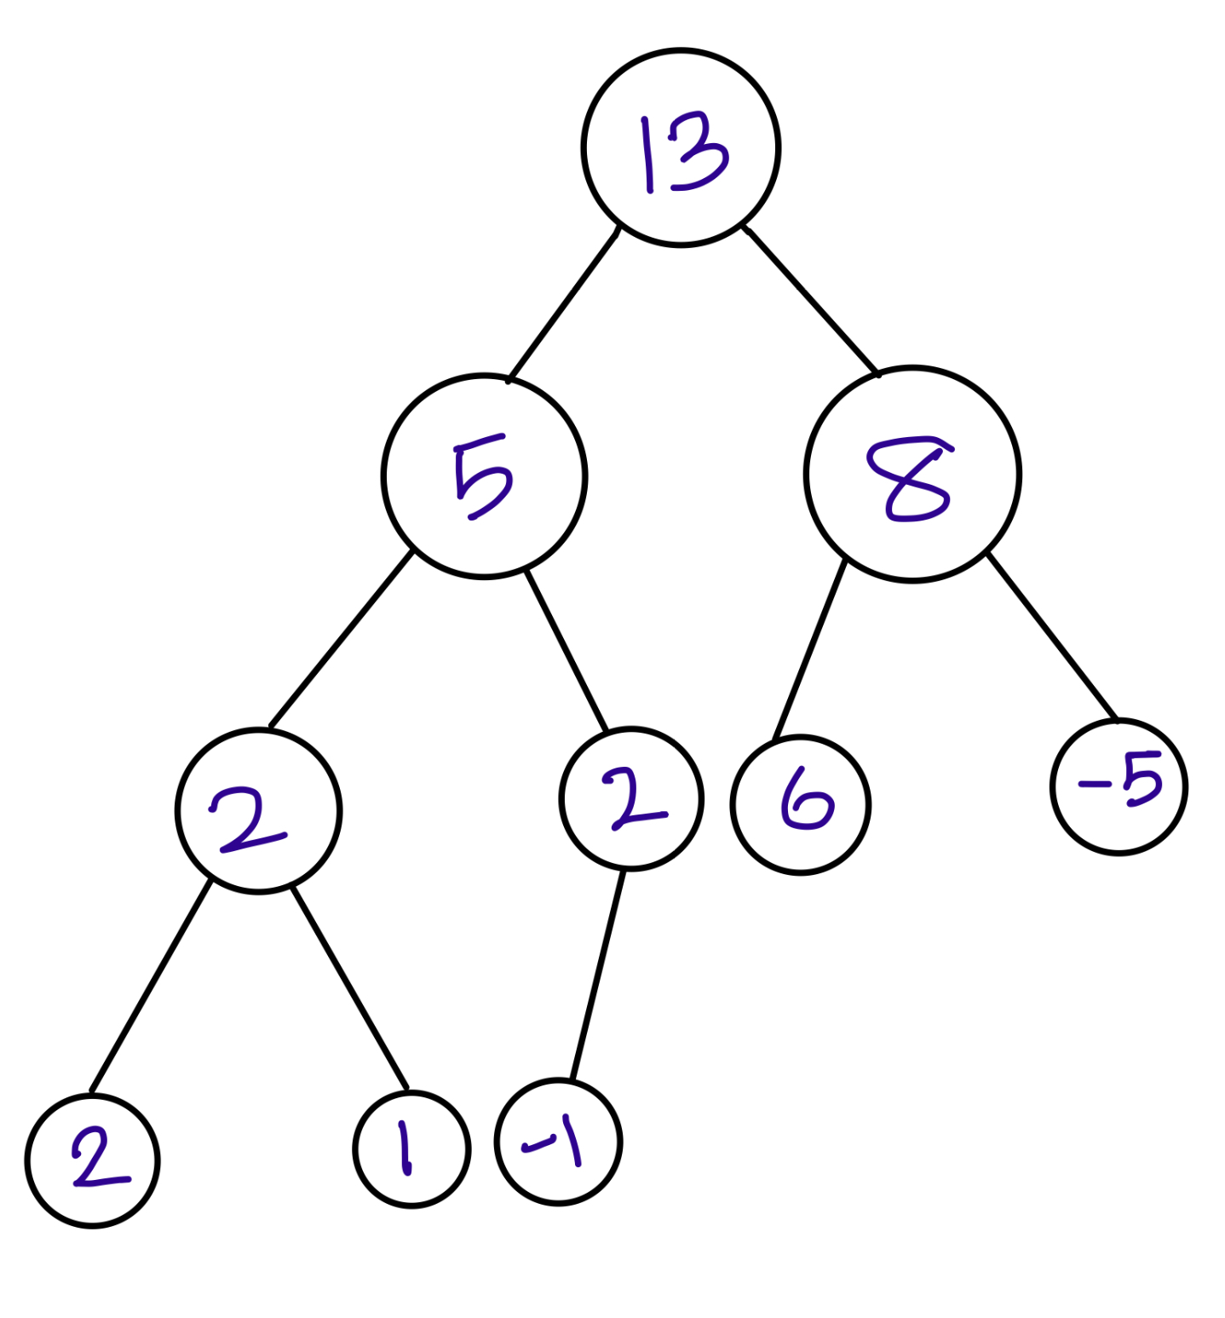
Heap - Delete

Slide 16
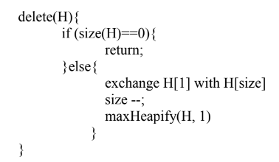
Heap - Delete (Pseudocode)

Slide 17
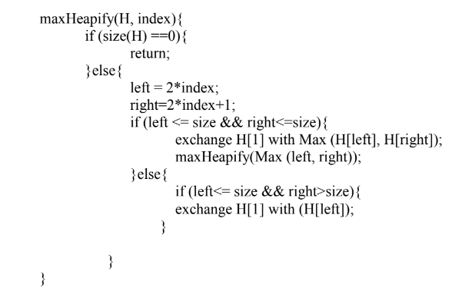
Heap - Sink (Pseudocode)

Slide 18
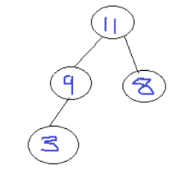
Heap Sort
Delete All Nodes

Slide 19

Heap Sort

Slide 20
Heap Sort

Slide 21
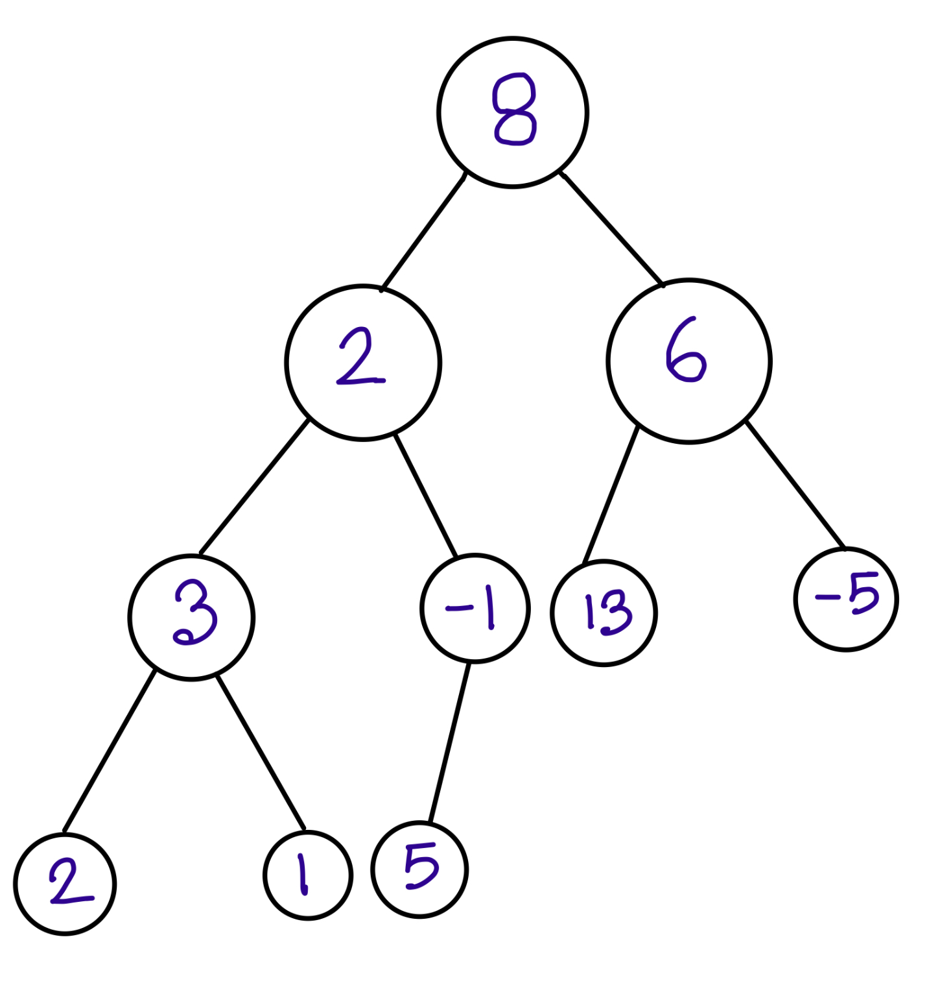
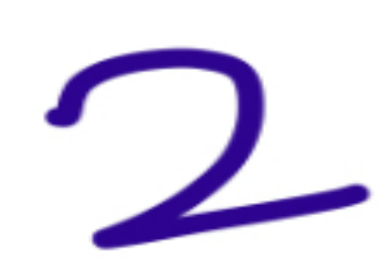
Heap - Build Heap
N | 8 | 2 | 6 | 2 | -1 | 13 | -5 | 2 | 1 | 5
Tree

Slide 22
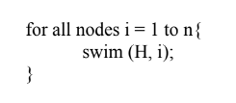
Heap - Build Heap
N | 8 | 2 | 6 | 2 | -1 | 13 | -5 | 2 | 1 | 5
Heap

Slide 23
Heap - Build Heap
N | 13 | 5 | 8 | 2 | 2 | 6 | -5 | 2 | 1 | -1
Heap

